Slide 1
Changes in matter
What’s the matter, don’t you want to learn about matter?

Slide 2
Social Experiment! :D
Spend 3 mins. making a list of words that describe the person sitting next to you (max 8)
Do you have words that describe their
Physical features
Personality
These words which describes the person are properties of the person!

Slide 3
Recap: Properties
Def: a quality or distinctive trait that describes an object or substance
Two types of properties
Physical
Qualitative physical property: detected by the 5 senses
Colour, shape, taste, odour
Quantitative physical property: measurable
Height, weight, diameter
Chemical
How something reacts when put in contact with something else

Slide 4
Recap: Properties
Multiple substances have lots of properties, however, some properties are characteristic and some are non-characteristic
Characteristic → specific properties for only one object/one group of objects
DNA of humans, fingerprints of individuals
Non-characteristic → properties that more than one object share/common to many objects
An orange, a car and Ms. Di Lallo’s top are all blue

Slide 5
Characteristic Properties for
Solids
Boiling point
Melting point
Density → number of grams of a substance that occupies a certain amount of space
Gases
Boiling point
Melting point
Density
**Reaction to lime water
**Reaction to a flame
Show link http://www.youtube.com/watch?v=LiAvDpl5aJA&feature=related

Slide 6
Changes!
What is a change?
Def: the process of becoming different
But there are different types of changes when it comes to science!
Physical change → changes which go from one state of matter to another, but don’t change the atomic structure!
Chemical change → changes which change the basic atomic structure

Slide 7
Physical Change
Looks different, but atomically is still the same
Nothing is broken down, it just looks different
Atomic structure prior and post change are still the same
Usually involves a phase change
Water going from solid form to liquid form
Melting butter

Slide 8
Phase Changes
Condensation → going from gas to liquid
Clouds, dew
Evaporation → going from liquid to gas
Steam from hot shower, boiling water
Fusion → going from solid to liquid
Popsicle melting, volcano erupting
Solidification → going from liquid to solid
Freezing water, hardening of melted butter
Sublimation → going from solid to gas
Fire extinguisher
→ going from gas to solid
Dry ice, moth balls

Slide 9
Chemical Changes
Looks different and is atomically different
Something new is formed!
Burning wood, rusting metal
Atomic structure prior and post the change are different

Slide 10
Common signs a Chemical change occurred
Bubbles form → Creation of a gas
Major color change
Heat/light given off
Change in mass → lighter or heaver than when started
Formation of a precipitate

Slide 11
Common signs a Chemical change occurred
http://www.youtube.com/watch?v=Yvp7-YzG-FQ&feature=related
http://www.youtube.com/watch?v=0lZBNbgBhkU&feature=related
http://www.youtube.com/watch?v=VIYwTN45X5o&feature=related
Couldn’t find clip
http://www.youtube.com/watch?v=khZIl9kv5Xc&feature=related

Slide 12
Chemical Reaction
Def: The breaking down or making of molecules!
The reactants
Everything to the left of the equation (arrow)
The stuff you have before you start the rnx
The products
Everything to the right of the equation (arrow)
The stuff you get after you mix them and finish the rnx!

Slide 13
Types of Chemical Reactions
Synthesis Reaction
Element + Element → Compound
Cu + O → CuO
Decomposition Reaction
Compound → Element + Element
H₂O → H₂ + O
Single Displacement Reaction
ab + cd → ac + bd
2CuO + C → 2Cu + CO₂

Slide 14
Synthesis Reaction
Element + Element → Compound
Clues as to figure out it is a synthesis reaction
Change in appearance
** Increase in mass **
Have only 1 product at end of reaction
Solid is produce (usually)

Slide 15
Decomposition Reaction
Compound → Element + Element
Clues as to figure out it is a decomposition reaction
Change in appearance
** Decrease in mass **
Two things are produced

Slide 16
Displacement Reaction
ab + cd → ac + bd
Clues as to figure out it is a single displacement reaction
Change in appearance
**No change in mass**
Two new things produced (which are different from the two things you started with)

Slide 17
Conservation of Matter
If there is only one thing you remember from this class, this is it!
Nothing is neither created nor destroyed, but is converted from one form to another!

Slide 18
Conservation of Matter
In plain English, it means that in a chemical reaction, you’re not creating matter or destroying it, but changing the matter into different types of particles
The mass of the matter at the beginning of the reaction equals the mass of the matter produced at the end of the reaction
This means that the number of atoms in the reactants must equal the number of atoms in the products!

Slide 19
Recap of Atoms/Molecules/Elements/ Compounds
Atom → smallest particle of matter
Smallest part of an element
Ag, Fe, H are all atoms
Molecules → combination of 2 or more atoms, which are either the same or different
NaCl, H₂O are all molecules
Element → can’t be broken down into simpler substances. Atoms or molecules that are made up of one or more identical molecules
Xe, O₂ are all elements
Compounds → can be broken down into simpler substances called elements.
CaCO3, NaCl, CO₂, CaCO₃, NaNO₂

Slide 20
Rules for balancing Chemical Equations Picture Way
Write the skeleton equation
“Photocopy” molecules until the same number of each atoms appear on each side
“Re-write” equations show the number of molecules involved in the chemical reaction
Key: The number of atoms in the reaction side must equal the number of atoms in the product side!

Slide 21
Examples
1. CH₄ + O₂ → CO₂ + H₂O
2. H₂ + O₂ → H₂O
3. FeCl₂ + Na₃PO₄ → Fe₃(PO₄)₂ + NaCl
4. Cu + O₂→ CuO
5. P + H₂→ PH₃
6. H₂SO₄ + Al → H₂ + Al₂(SO₄)₃

Slide 22
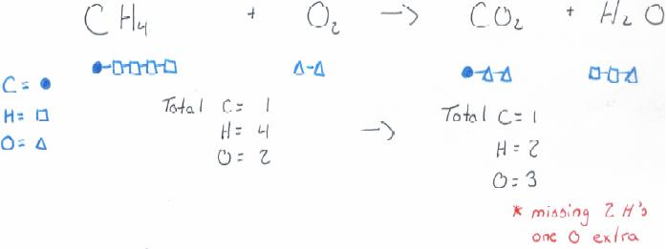
CH₄ + O₂ → CO₂ + H₂O

Slide 23
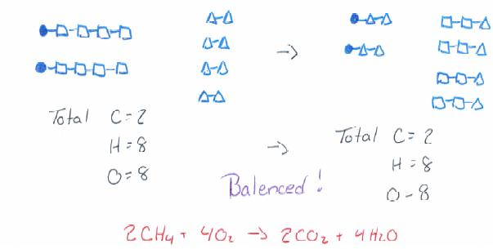
CH₄ + O₂ → CO₂ + H₂O

Slide 24
H₂ + O₂ → H₂O

Slide 25
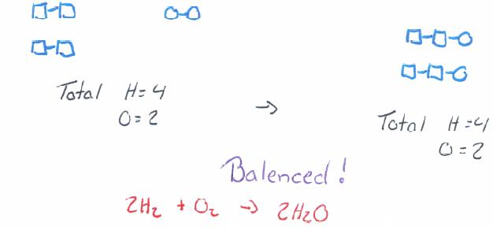
H₂ + O₂ → H₂O

Slide 26
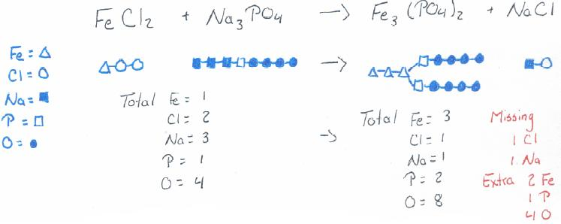
FeCl₂ + Na₃PO₄ → Fe₃(PO₄)₂ + NaCl

Slide 27
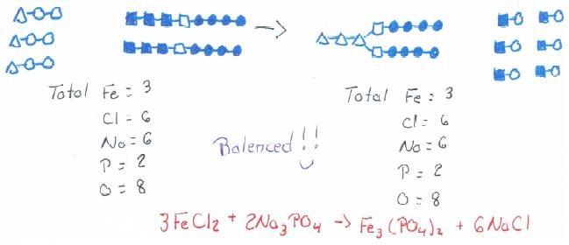
FeCl₂ + Na₃PO₄ → Fe₃(PO₄)₂ + NaCl

Slide 28
Practice Balance the Following Equations
WORKSHEETS!
-The more you practice balancing equations, the less you need to draw them all out, and the more you can do it just by doing a numbers game ☺

