Slide 1
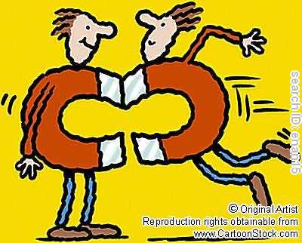
Magnets Review
We’re magnetic!

Slide 2
What’s a magnet?
A magnet is a material or object that produces a magnetic field
Question: What is a magnetic field then?
A force that pulls on certain materials, and attracts or repels other magnets
Is created by the rotation of electrons around the nucleus of each atom

Slide 3
Classification of Materials
Magnetic
A material which is strongly attracted to iron, nickel or cobalt
It also repels or attracts another magnets
Ferromagnetic
Is attracted to a magnet
Becomes magnetic temporarily (is only a magnet as long as in the presence of a magnet)
Becomes demagnetized if tapped
Non-magnetic
Not attracted by a magnet at all

Slide 4
Magnetic Theory
Only magnets and ferromagnetic substances are affected by magnetic fields
In these materials, small groups of atoms band together in areas called domains.
The electrons of the atoms in a domain are all in the same magnetic orientation.
The electrons are all oriented in the same way!

Slide 5
Magnetic Theory
In a non-magnetized ferromagnetic substance, these domains are in a random order
When these substances are placed in a magnetic field, their domains will align in the same direction as the field, and become magnetized!
The moment the magnetic field is removed, ferromagnetic substances remain magnetic for only a short while, and their domains loose their specific arrangements
Note, the domains in magnets are always aligned!

Slide 6
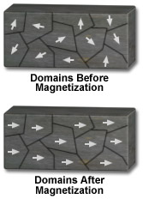
Magnetic Theory

Slide 7
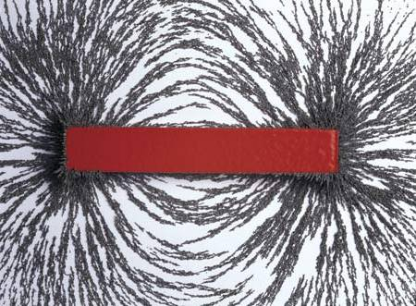
What’s the shape of a magnetic field
Bar Magnet

Slide 8
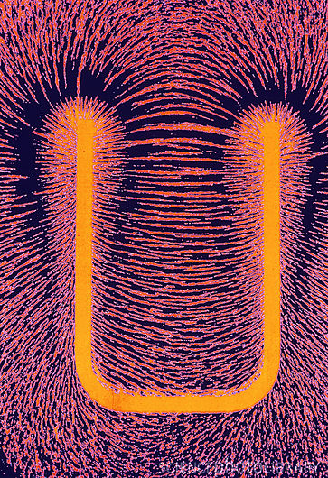
What’s the shape of a magnetic field
Horseshoe Magnet

Slide 9
Magnetic Fields
All magnetic fields have the following characteristics:
A north and a south pole
The lines of force goes from one pole to the other pole
They start from the north and end at the south
The lines of force never intersect!!!
Like poles repel one another, whereas opposite poles attract one another

Slide 10
Law of Magnetism
Like poles repel one another
Two north poles will repel one another! None of the lines of force will go near the pole. The lines of force will go towards their own south poles
Opposite poles attract one another
A north pole will attract with a south pole! The lines of force will start from the north pole and head to the south pole

Slide 11
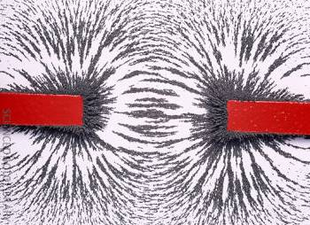
Attraction between Magnetic Poles

Slide 12
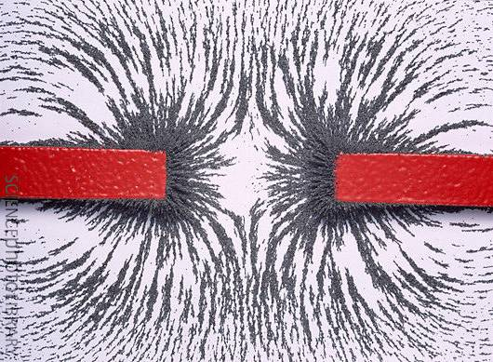
Repulsion between Magnetic Poles

Slide 13
How compasses react to magnets
The red end of a compass needle is attracted to the south pole of a magnet
Therefore, the red end of a compass is that compass’s north pole!
Question: why does the red end of a compass needle point towards the North Pole where Santa lives?
The Geographical North Pole is a MAGNETIC SOUTH POLE!

Slide 14
Magnetic Remanence
Def: Ability of a material to acquire and keep its magnetic properties
Two types of magnets
Temporary →they loose their magnetic ability quickly
Permanent → they stay magnetic for a long time

Slide 15
Magnetic Remanence
So, materials that stay magnetic for a long time have high magnetic remanence
Same applies to materials that don’t stay magnetic for a long time. Materials that are only magnetic for a short time have low magnetic remanence

Slide 16
Electromagnetism
In short, joining of electricity and magnetism! Remember magnetism has to do with the alignment of the electrons in atoms
When you have an electronic current, the motion of electrons are going in the same direction
Therefore, my electrons have the same orientation!
When you have a dynamic current flowing, you produce a temporary magnetic field!
No current = no more field

Slide 17
Right Hand Rule!
Used to determine the direction of the magnetic field lines generated by a live wire
You’re thumb : points in conventional current direction
Tip of thumb points to (-) terminal. Butt of hand is pointing to (+) terminal
Your fingers: show direction of magnetic field line
The curling of your fingers grabbing the “wire” curl in the direction the wire is going

Slide 18
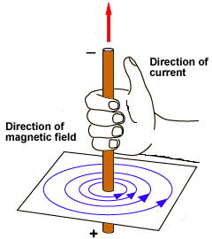
Right Hand Rule!

